Slide 1




Customer Demographics and Purchase Behavior Analysis Summary
By: Thambidurai Sundaramoorthy

Slide 2

Content
01
Introduction
02
Objective
03
Overview
04
Region Highlights
05
Product Category Highlights
06
Summary of Tasks
07
Business Insights
08
Contact

Slide 3


Introduction
Domain:
XYZ is a retail domain which has 5 different product categories like Books, Electronics, Fashion, Home & Kitchen and Toys. They are selling their product across different regions like East, West, North and South for different age customers from 18 to 70. They would like to understand the current trend to optimize their marketing.
Project:
XYZ retail would like to understand the customer demographics and purchasing behavior trends to optimize their marketing and inventory strategies for different product categories in different regions for different age customers.

Slide 4
Objective
As a Business Analyst, the objective of the project is to analyze and visualize customer demographics, product categories, and purchase patterns using the provided dataset.
The business use case is of follows:
To identify the key customers to develop marketing strategies.
To understand the purchase trends to forecast the future sales and inventory needs.
To analyze the performance of different product categories and their impact on revenue contribution.
Insights to improve marketing strategies for different regions and age groups.

Slide 5
Overview
5000
27397
69.4 Lakhs
5
Total Customers
Total Purchases
Total Revenue
Total Product Categories
Totally, there are 4 regions including East, West, North and South.
There are 5000 customers in overall.
There are 5 product categories such as Books, Electronics, Fashion, Home & Kitchen, Toys.
The overall purchases were 27397 with the revenue of 69.4 Lakhs in total.

Slide 6

Region Highlights
Highest Customers
Highest Revenue
Out of 4 regions, North region has many highlights.
Highest customer base of 1307.
Highest purchases of 7136.
Highest revenue of 17.9 Lakhs.
Highest revenue generated in 3 product categories which includes Books, Fashion and Toys.
North
Highest Purchases
Books, Fashion & Toys

Slide 7
Product Category Highlights
Out of 5 product categories, Home & Kitchen product category has many highlights.
Highest revenue of 14.2 Lakhs.
Highest purchases of 5572.
Highest revenue of 1.88 Lakhs in Home & Kitchen product category was from 30 to 35 age group.
East region has a highest revenue of 3.69 Lakhs in Home & Kitchen product category.
Highest Revenue
Highest Purchases
Home & Kitchen
30 to 35 age group
East

Slide 8

Summary of Tasks 1:
Consolidated the raw data.
Verified the data types of each column and updated in the standard format and changed the date format.
Created the pivot table.
All the tasks were created using the consolidated data and the pivot table.
1. Styling Tabulation
The header text has been formatted to the bold letters.
The entire dataset table contents have been applied with an alternating row colors using medium grey theme from the styles format.
Amount column values data types have been changed to currency data type.
2. Age Distribution Histogram – To identify most prominent age groups
Using pivot table, grouped the ages with a group of 6 from 18 to 70.
The most prominent age groups are between 24 to 29.
This age group customers are highest with 586 customers out of 5000 customers.

Slide 9

Summary of Tasks 2:
3. Box plot for Purchase Amounts – Outliers and Median purchase amounts
Home & Kitchen product category is an extreme in terms of purchase amount due to which it is termed as outliers with 14.2 Lakhs.
The median purchase amount of the product category is Books with 13.8 Lakhs.
4. Pie chart for Customer Distribution – Highest Customer base region
The North region has the highest customer base with 26% from the overall customers.
5. Donut chart for product revenue contribution
The contribution of each product category in terms of revenue is of follows:
Home & Kitchen – 20.5%
Fashion – 20.1%
Books – 20%
Electronics – 19.9%
Toys – 19.5%
6. Stacked Bar Plot for Regional Revenue by Gender
The North region has a highest sales revenue of 17.9 Lakhs compared to other regions.
Both male and female gender tops the revenue in North region compared to other regions where as East region has a highest revenue for other gender category.
Highest Revenue by Gender: Male – 6.26 Lakhs, Female – 5.95 Lakhs and Other – 6.31 Lakhs.

Slide 10

Summary of Tasks 3:
7. Relative Stacked Bar Plot for Age Groups – Proportion of purchases
Using pivot table, grouped the ages with a group of 6 from 18 to 70.
The maximum proportion of purchases made by the age groups of 24 to 29 and 30 to 35 with 12% of purchases.
The least purchases were made by the age group 66 to 71 with 10% where as remaining age groups have a proportion of purchases of 11%.
8. Stacked Area Plot for Monthly Revenue – Across Product Categories
The Books and Electronics product categories contributed the most during the month of January.
The Fashion and Toys product categories contributed the most during the month of October.
The Home & Kitchen product category contributed the most during the month of June.
Except toys product category, all other products contributed least during the month of December compared to other months.
10. Bar plot for total purchases – Most Popular Product Categories
The Home & Kitchen product category has a highest purchase of 5572 which is being termed as the most popular product category among all.
12. Line plot for monthly purchase trends – Peak Shopping Period
The monthly purchase trend analysis showed the peak shopping period was during the month of October as it the highest purchase of 2410.

Slide 11
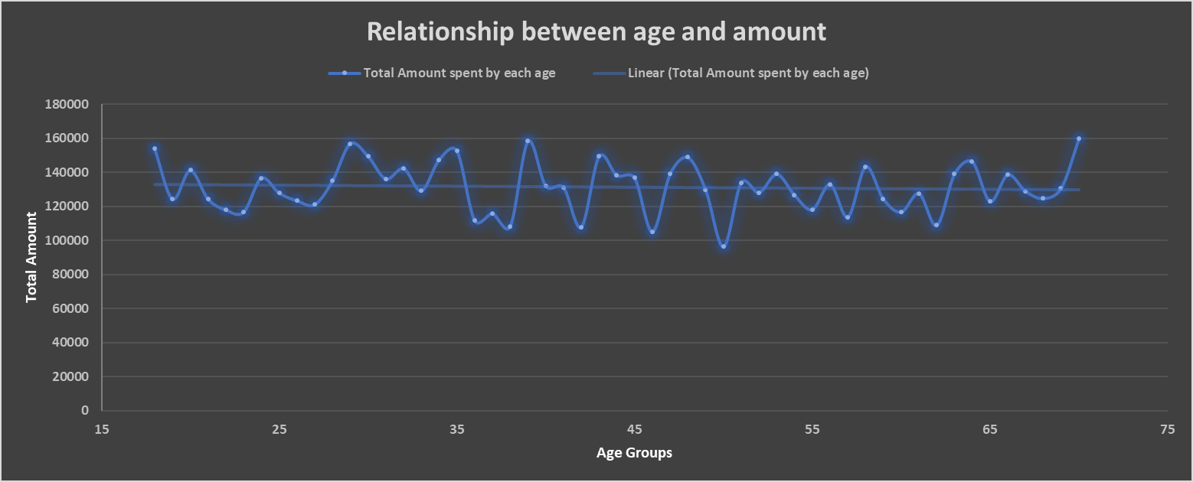
Summary of Tasks 4:
9. Scatter plot for Age vs Purchase amount – Relationship between age & amount
The relationship between age and purchase amount has been explored and visualized through below scatter plot.
This scatter plot is to identify the trends in spending behavior.

Slide 12
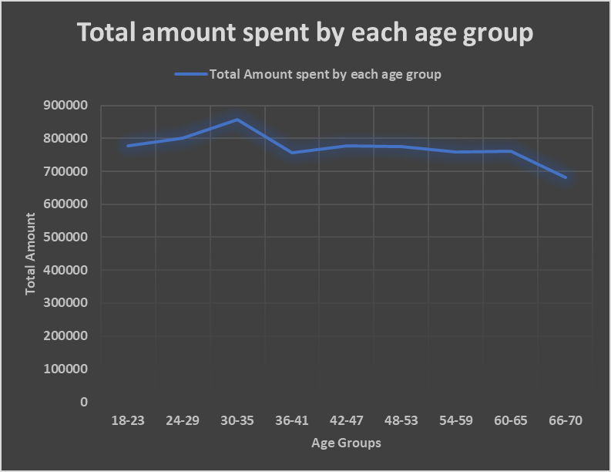
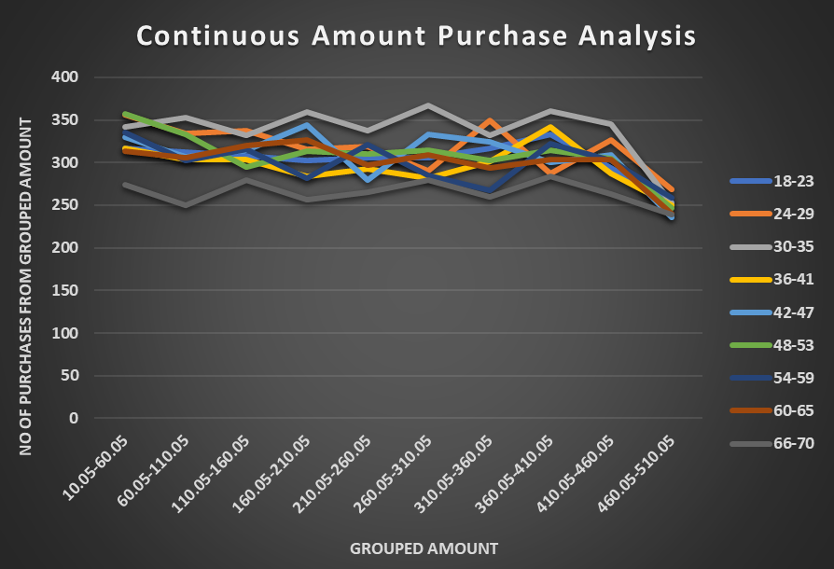
Summary of Tasks 5:
11. Continuous vs Continuous Analysis – To identify correlation or trends
In graph 1, age has been grouped with a group of 6 from 18 to 70 and the total amount spent by each age group has been visualized to understand the trend through continuous analysis.
In graph 2, both age and amount has been grouped with certain values. Amount has been grouped with a group of 50 from 10.05 to 510.05. This analysis provides the continuous amount purchases by each age group through visualization.

Slide 13


Business Insights
Customer Analysis:
Overall, there are 5000 unique customers.
North region has maximum customers with 26% from the overall customers.
Maximum of 12% customers from are in the age group between 24 to 29.
Purchase Analysis:
Overall, 27397 purchases were made by the customers.
The maximum purchased category was Home & Kitchen with 5572 purchases where as Toys category was the lowest.
The maximum purchases were from North region with 7136 purchases where as South region has the lowest.
The maximum number of purchases from other gender category with 9345 purchases.
The maximum number of purchases was by the age group between 30 to 35 of 3379 purchases.
The highest purchase was happened during the month of October of 2410 purchases where as the lowest purchase was during December month.
The maximum purchases made by unique customers are 10.
Revenue Analysis:
The overall revenue amount is 69.4 Lakhs.
Home & Kitchen product category has a highest revenue of 20.5% where as toys category was the lowest.
North region has a highest revenue of 25.9% where as South region has the lowest.
The highest revenue was from other gender category of 34.1%.
The maximum revenue generated was during October month of 6.1 Lakhs and December has the lowest.

Slide 14


THANK YOU
Thambidurai Sundaramoorthy
stdurai95@gmail.com

